Slide 1
The Spark Foundation
(GRIP AUGUST 2021)
Web and Mobile Development Task
Task 3:- CI/CD (Cloud Computing)
Name:- Adarsh Kumar

Slide 2
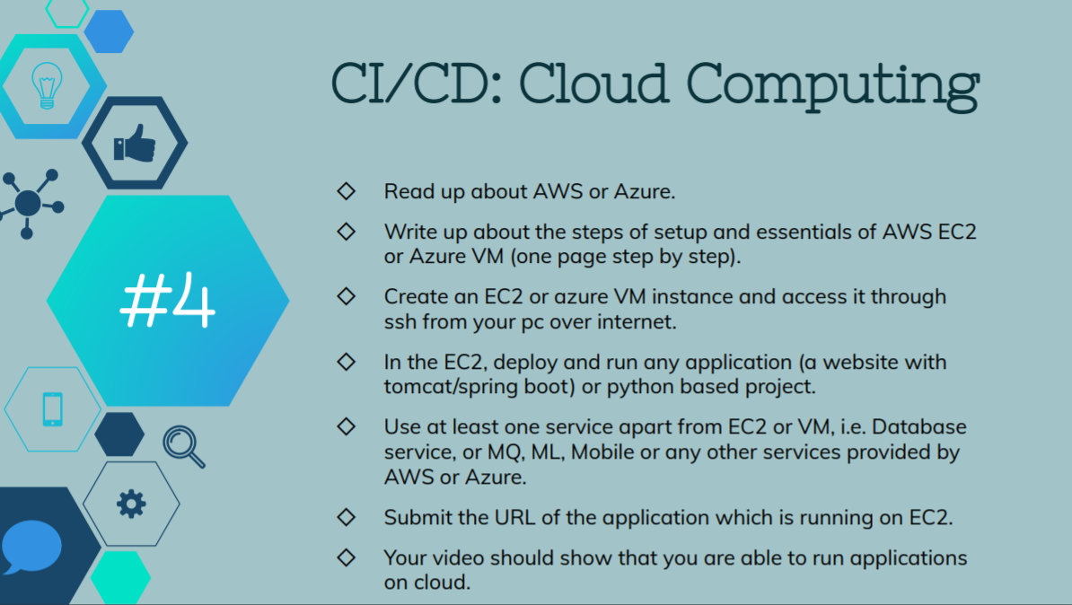

Slide 3
Steps for EC2 setup for Instance:-
• Log into your AWS Account
• To launch the EC2 instance and mount an EFS file system
1. Open the Amazon EC2 console at https://console.aws.amazon.com/ec2/.
2. Choose Launch Instance.
3. In Step 1: Choose an Amazon Machine Image (AMI), find an Amazon Linux 2 AMI at
the top of the list and choose Select.
4. In Step 2: Choose an Instance Type, choose Next: Configure Instance Details.
5. In Step 3: Configure Instance Details.
6. Choose Next: Add Storage.
7. Choose Next: Add Tags.
8. Name your instance and choose Next: Configure Security Group.

Slide 4
9. In Step 6: Configure Security Group, set Assign a security group to Select
an existing security group. Choose the default security group to make sure that it can
access your EFS file system.
You can create a new security group that allows SSH. You can use the following settings to add SSH access:
• Type: SSH
• Protocol: TCP
• Port Range: 22
• Source: Anywhere 0.0.0.0/0
10. Choose Review and Launch.
11. Choose Launch.
12. Select the check box for the key pair that you created, and then choose Launch Instances. Then Instance will be created(running).

Slide 5
Essentials of AWS EC2:
• Amazon Elastic Compute Cloud (Amazon EC2) is a web service that provides secure, resizable
compute capacity in the cloud. It is designed to make web scale cloud computing easier for developers.
• Amazon EC2’s simple web service interface allows you to obtain and configure capacity with minimal
Friction also Optimize, Compute Performance, and Cost with Amazon EC2 Fleet.
• Amazon EC2 presents a true virtual computing environment, allowing you to use web service
Interfaces to launch instances with a variety of operating systems, load them with your custom
application environment,manage your network access permissions, and run your image using as
many or few systems as you desire.
• You can hibernate your Amazon EC2 instances backed by Amazon EBS, and resume them from this
state at a later time.

Slide 6
• Amazon EC2 bare metal instances provide your applications with direct access to the processor and
memory of the underlying server. These instances are ideal for workloads that require access to
hardware feature sets, or for applications that need to run in non-virtualized environments for
licensing or support requirements.
• Customers requiring massive floating point processing power will benefit from the next-generation of
general-purpose GPU compute instances from AWS, Amazon EC2 P3 instances with up to 8
NVIDIA® V100 Tensor Core GPUs.
• Paying for What You Use You will be charged at the end of each month for your EC2 resources
actually consumed. o Amazon Machine Images (AMIs) are preconfigured with an ever-growing list of
operating systems.

Slide 7
LIVE DEMO

Slide 8
(AWS-S3)
Uses of AWS service other than EC2
• Log into aws management console.
• Go to Services and click on S3 service from the Storage.
1: Create an Amazon S3 Bucket.
• Click CREATE BUCKET and add name to it.
• Choose region.
• Now click on CREATE BUCKET.
• Bucket is created successfully.
• Open it.

Slide 9
2. Upload a file to your Amazon S3 Bucket.
• Click on CREATE FOLDER and name it.
• Folder created successfully.
• Click on ADD FILES and upload a file.
• Select any file from your system and Upload it.
• FILE uploaded successfully.
3. Retrieve a file from your Amazon S3 Bucket.
• Go to action and select DOWNLOAD option.
• File downloader Successfully.

Slide 10
4. Delete a file to your Amazon S3 Bucket.
• Select a file from S3 Bucket and Click Delete.
• Select PERMANENT DELETE.
• Click on DELETE OBJECT.
• File Deleted Successfully.
This is the way to Create Bucket, Upload, Retrieve,
and Delete Files from AMAzon S3 Services.

Slide 11
LIVE DEMO

Slide 12


